Slide 1










Website Project
Rasai

Slide 2





Contents
INTRODUCTION
SITEMAP
1
6
REQUIREMENTS
WEBSITE
2
7
MoSCoW
DATA ANALYTICS
3
8
USE CASE DIAGRAMS
FINAL MoSCoW
4
9
DESIGN
CONCLUSION
5
10

Slide 3








About US
Our passion: Creating impressive, user-friendly websites.
Our team: Developers, Designers, Testers, Database Strategists, united to bring visions to life.
GREAT TEAM!
Notes:
Our passion: Creating impressive, user-friendly websites.
Our team: Developers, Designers, Testers, Database Strategists, united to bring visions to life.

Slide 4
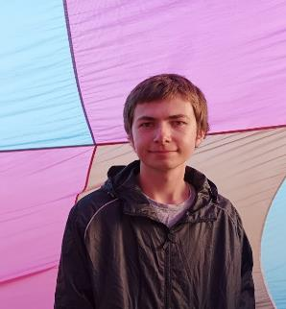
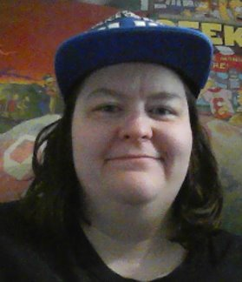





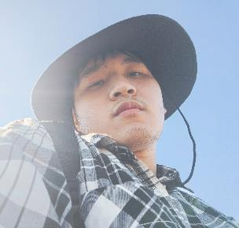
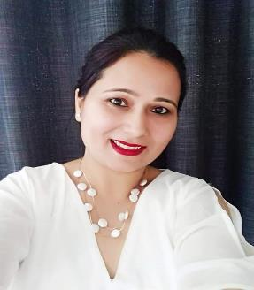
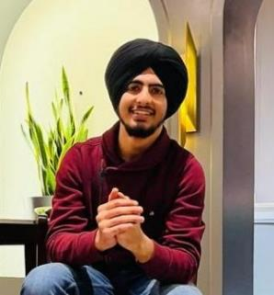
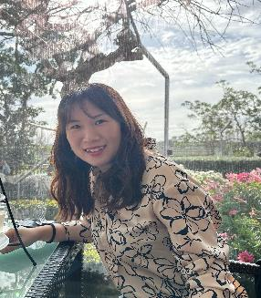
Matthew
Natasha
Designer
Web Developer
Licheng
Network Security
Gagan
Prabhdeep
Software Tester
Software Engineer
Jung
Database

Slide 5



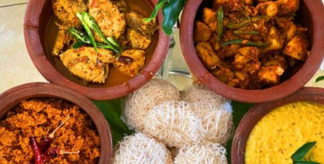
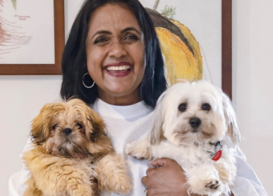





RASAI
Rasai specializes in catering services, offering a delectable array of Sri Lankan cuisine.
Dhammika Silva is the proprietor of Rasai, a platform exclusively designed for facilitating food orders for events.
Professionalism
Commitment
Quality
Notes:
1. Quality: Rasai uses fresh, high-quality ingredients and preparing delicious, well-presented dishes.
2. Professionalism: Rasai is upholding high standards of professionalism in all interactions, from initial inquiries to event execution.
3. Commitment: Their commitment to excellence and customer satisfaction drives everything we do.

Slide 6






Admin Dashboard
Booking System Integration
SEO Optimization
Requirements
Brand Visibility through Social Platforms
User-Centric Redesign
Notes:
1. Booking system: Developing a web application with integrated booking functionality for enhanced customer convenience.
2. User centric Design: Enhancing website usability and appeal for better user experience.
3. Admin Dashboard: Introducing an intuitive backend interface for efficient website management.
4. Seo optimisation: Prioritizing strategies to improve search engine ranking and drive increased web traffic.

Slide 7


MOSCOW
Must Have
Designing a new logo.
Creating an Admin Page.
Creating a Booking Page.
Automating order emails to client's mail address.
Creating contact page and recreating footer.
Could Have
Won't Have
Should Have
Social Media pages for the brand.
Review section on the home page.
SEO Optimization.
Data Analytics
Adding more images to the page.
Tag line for the brand name.
Embedding a calendar for the booking page.
Admin’s access to change menu Items
Payment portal on the web app.
SMMA Campaigns for the business.

Slide 8



Updated Use Case Diagram
Customer
Admin management system
Owner
Request an event
Request event date
Request event menu
Check event availability
If > the event available
Else >
Request customer details & event information
Request changing condition
Provide customer details & event information
Create a booking
Send event confirmation & invoice email
Confirm the event
Confirm the booking
Send booking confirmation & invoice email
Confirm the Booking
Send client notification email
Complete the order

Slide 9







LOGO DESIGN
1
Includes company name
and tag line
Oval-looking in a “dish” shape
Colour green is used to
represent food.
.
2
3

Slide 10


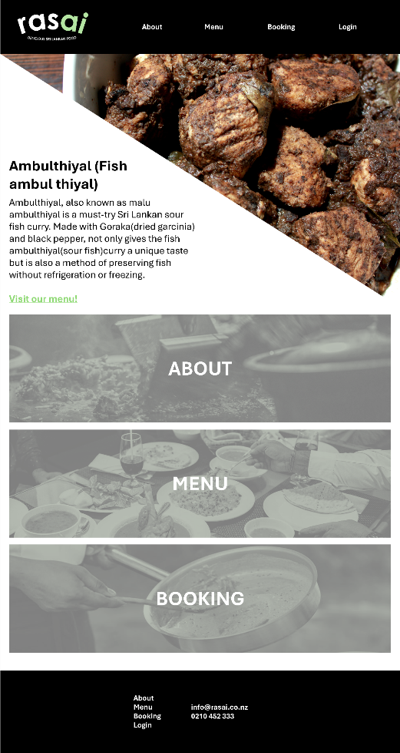





Home page
1
About, food menu, and booking shortcuts lead to their respective pages.
Top navigation bar will show the logo and links to each page (including the login page for admin).
Bottom footer will include contact details.
2
3

Slide 11
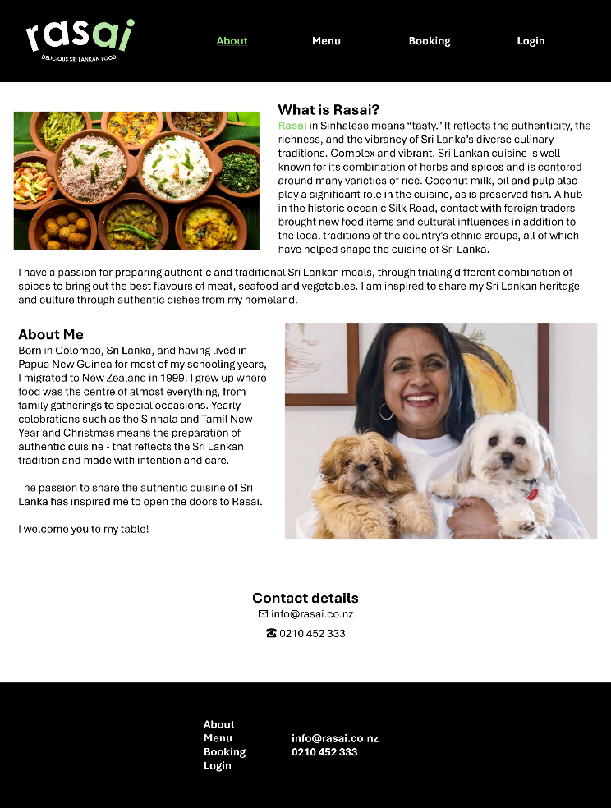
About page
Info and history about the company with photos.

Slide 12
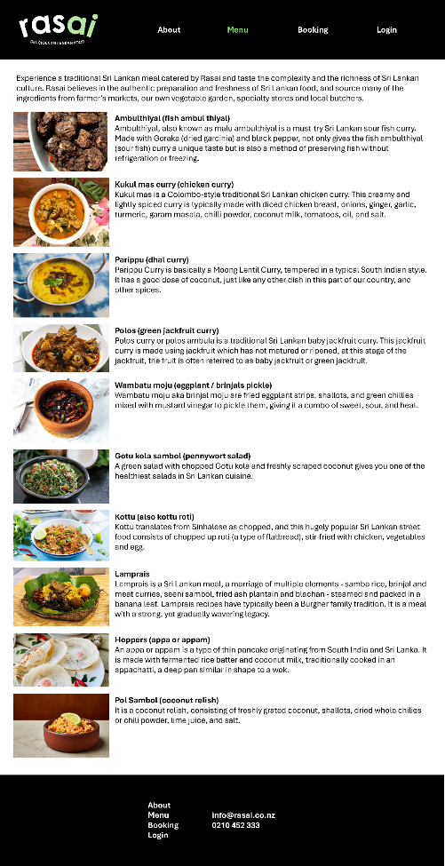
Food menu page
What’s on the menu, with pictures.

Slide 13
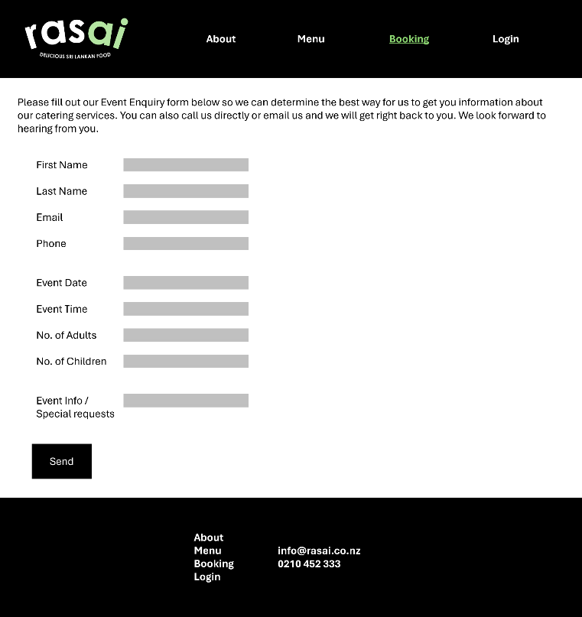
Booking page
Book your planned events here.

Slide 14
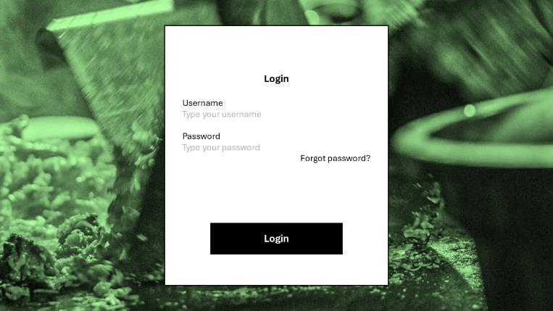
Login page
Admin can log in using a username and password here.

Slide 15
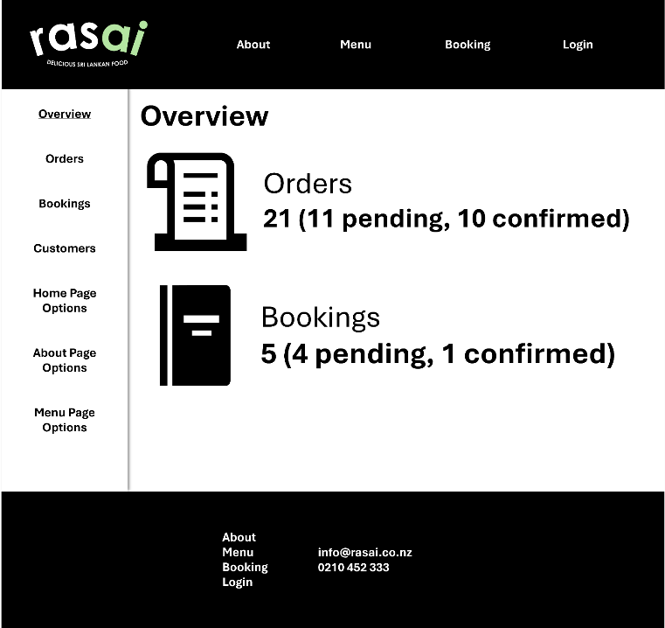
Admin page
Admin can access all the pages on the Web App
Can view, update, delete or create new menu items
In future, admin could be able to see the orders and bookings from the admin page.

Slide 16


RASAI Sitemap
Home
About
Menu
Admin
Booking
Login
Our Story
Menu images
Booking
As popup screen
On Home Page
About Dhammika
Event
Menu descriptions
Customer
details
User name
Special
Request
Contacts In footer
User name

Slide 17

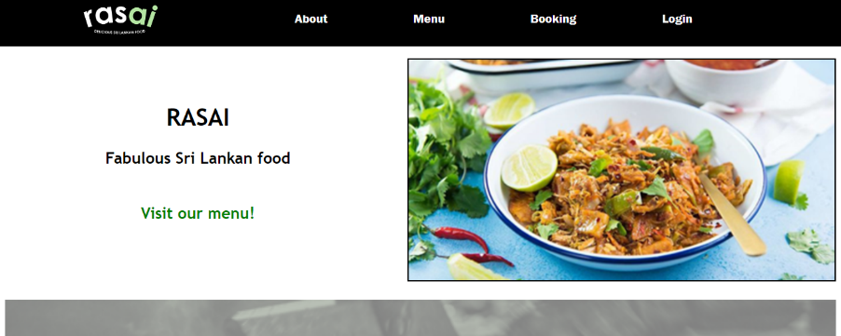
RASAI Website
Time to demonstrate the website!

Slide 18
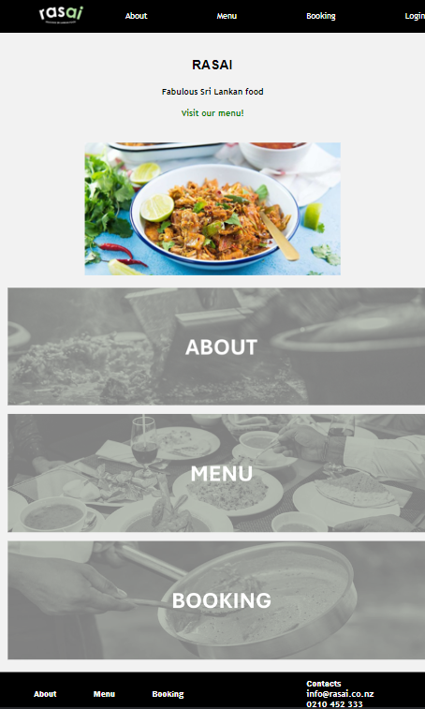
SOFTWARE
Working Functionality
Admin Page
Integrated Menu Items Database
CRUD Functionality on Menu Items

Slide 19
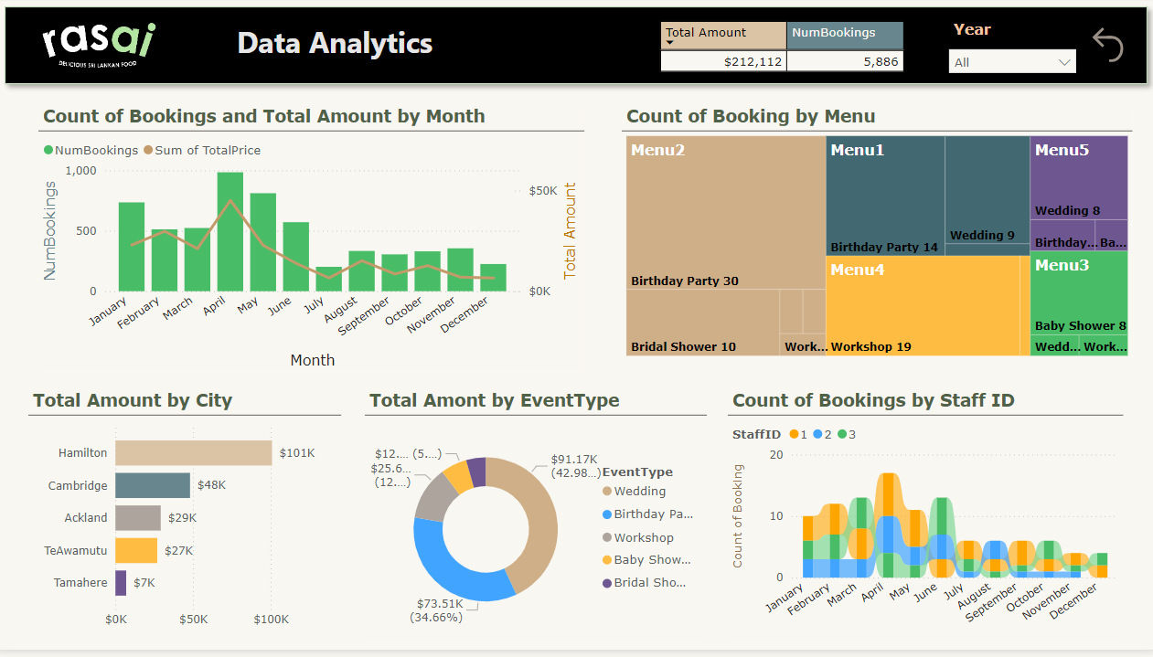

Slide 20

MOSCOW
Must Have
Designing a new logo.
Creating an Admin Page.
Creating a Booking Page.
Automating order emails to client's mail address.
Creating contact page and recreating footer.
Could Have
Won't Have
Should Have
Social Media pages for the brand.
Review section on the home page.
SEO Optimization.
Data Analytics
Adding more images to the page.
Tag line for the brand name.
Embedding a calendar for the booking page.
Admin’s access to change menu Items
Payment portal on the web app.
SMMA Campaigns for the business.

Slide 21









Conclusion
User Friendly
Customer Engagement
Easy
Maintenace

Slide 22

Questions?

Slide 23

Thank you for your attention.

